Slide 1


Slide 2
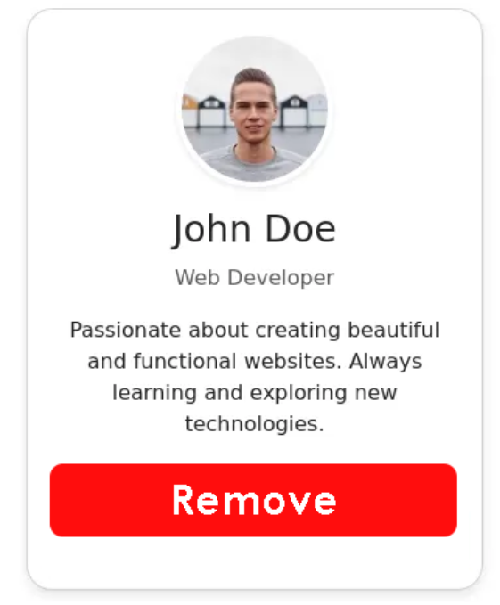
Day 1 : Dynamic Profile Card
Objective: Learn to dynamically populate a user profile card using data binding and handle user interaction in Angular.
Create a component called “Profile Card”
Populate the “image”,"Name", "Job," and “Bio" fields within the profile card template using data from your TypeScript component.
When the “Remove" button is clicked, display an alert box with the message: “Removed Successfully!"
Ensure all content (Name, Job, Bio,image) displayed in the HTML template is dynamically read from your TypeScript component.
Avoid hardcoding any of this information directly in the HTML.
Make User Name Upper Case
Bonus: When Remove is Clicked, Card should be removed from Dom.
Visual Aid:
Refer to the provided image for the desired layout and elements of the profile card.

